Slide 1

MRM - 03 ISO14001:2004 & OHSAS18001:2007
Date : 6th Jan 2017
Dhairyasheel Shinde
Dy. Management Representative & Management Appointee

Slide 2
Agenda
To review status - EMS & OHSAS activity
Occupational Health & Safety Policy , Environment Policy Review
Employee Participation
Results of Internal Audit & Certification Audit
Legal Register / Statutory Compliance
Testing & inspections
Incidents
Hazardous waste disposal
Legal Updates for EHS
Follow up action from previous MRM
Resource Requirement

Slide 3
EMS & OHSAS activity status
Sr. No. | Activity | Status
1 | Certification Audit | Completed
2 | MRM | Scheduled on 14th Feb 2017
3 | Review with Core committee member | July, October , January, April
4 | Internal Audit | 15th & 16th November 2016
5 | Objective & Targets | Reviewed in Jan 2017
6 | Awareness Training | Every Month
7 | Surveillance Audit | May 2017

Slide 4
Policy Review
Occupational Health & Safety Policy
Current policy is signed by Mr Vinod Gupta which needs to be review for change.
Environment Policy
Current policy is signed by Mr Vinod Gupta which needs to be review for change.

Slide 5
Employee Participation
Safety Committee Meeting are being conducted very month.
July 2016 – Dec 2016. (6 meetings)
Employee Participation :
Participation of employees in Aspect Impact & Hazard Identification and Risk Assessment by Core committee members. Further this needs to review & approved by HOD’s. Also this needs to percolate down the line.
Points discussed | Action Taken & completed | In progress
41 | 25 | 16
Safety Week | World Environment Day

Slide 6
Results of Certification Audit
ISO 14001: 2004
BS OHSAS 18001:2007

Slide 7
Legal Register
Sr. No. | License | Valid upto | Remark
1 | Consent to Operate ( Coal) - MPCB | Feb 2019 | Combine consent granted.
2 | Hydrogen & Liq. Nitrogen storage - PESO | 31/03/2016 | As recommended by CCoE Safety Audit in form 33 is carried out as p process for name change.
3 | Provisional Fire NOC - MIDC | 21/06/2017 | Work is in progress for Warehouse 2 & 3 sprinkler system . Erection will be completed by Feb 2017.
4 | Hazardous Waste Annual Returns | 20/06/2016 | Submitted
5 | Annual Environment Statement Report | Sept 2016 | Submitted

Slide 8
Testing & Inspections
Sr. No. | Particulars | Tested on | Remark
1 | Pressure Vessel testing | Sept 16 | Reports available.
2 | Lifting tools & Tackles | July / Aug 16 | Complied
3 | Hoist & Lifts | Jan 17 | Complied
4 | Storage tank calibration | Latest Dec.15 | Complied
5 | Stack monitoring | December 16 | Complied
6 | Ambient air monitoring | December 16 | Complied
7 | Noise Monitoring | December 16 | Complied
8 | Drinking water testing | December 16 | Complied
9 | ETP Inlet & Outlet | December 16 | Complied
10 | Sewage | December 16 | Complied

Slide 9
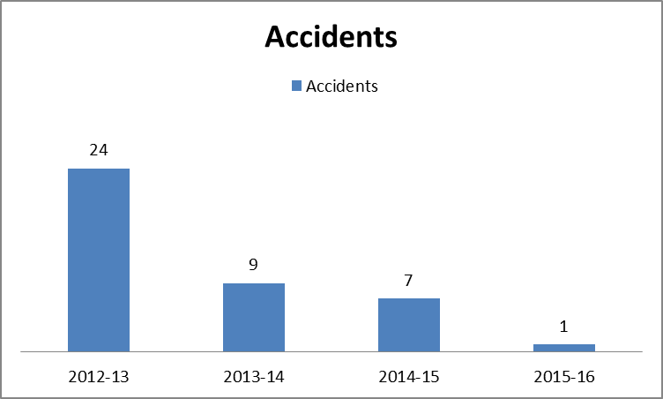
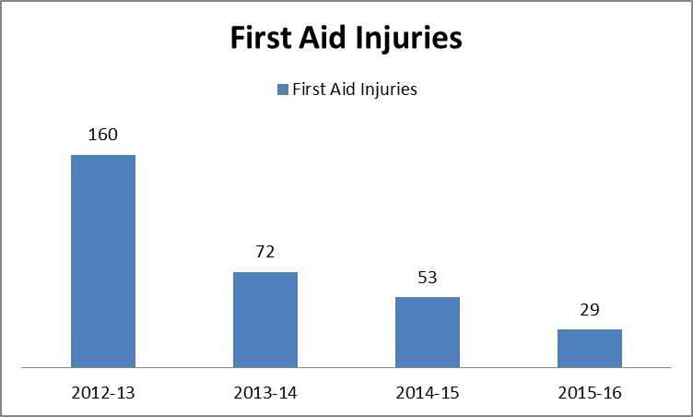
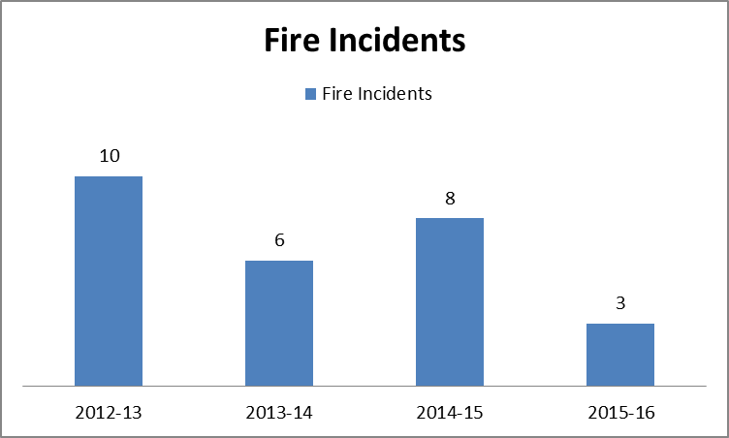
Incident

Slide 10
Hazardous Waste Disposal
Sr. No. | Hazardous waste | Quantity as per CTO | Quantity Disposed upto 31st Dec 2017 (FY 2016-17)
1 | Used oil | 13 KL/A | NIL (3.79 MT)
2 | Used Thermic fluid | As & when generated | NIL
3 | Filter Cake | 100 MT/A | 36.21 MT (67.94 MT)
4 | Spent Catalyst | 150 MT/A | NIL
5 | Spent Carbon | 20 MT/A | NIL
6 | MS Drums | 1000 No / A | NIL (63 no.s)
7 | HDPE Barrels | 1000 No / A | 121 Nos. (215 no.s)
8 | ETP sludge | 35 MT/A | 18.34 MT (33.45 MT)
9 | Nickel Compound | 150 MT/A | 35.43 MT (50.76 MT)
10 | Copper Compound | 30 MT/A | 21.67 MT (61.52 MT) wet basis
11 | Spent Zinc Compound | 10 MT/A | NIL
12 | Waste residue containing oil | 5 MT/A | NIL
13 | Used Batteries | As & when generated | NIL (390 no.s)
14 | Electronic waste | As & when generated | NIL
15 | Bio Medical waste | As & when generated | NIL

Slide 11
Legal Updates for EHS
Plastic Waste Management Rules 2016.
Hazardous & Other Waste (Management & Transboundary Movement ) Rules, April 2016.
MPCB Water Cess to be fill online.

Slide 12
Follow-up action from Previous MRM
Statutory Compliance
Provisional Fire NOC renewal – Completed.
MPCB consent for Coal Fire Boiler – follow-up – Completed.

Slide 13
Resource Requirement

Slide 14
Thank You

